Slide 1


University of Basrah
Al-Zahraa Medical College
Ministry of higher Education and Scientific Research
Academic year 2021-2022
5th year
REPRODUCTIVE BLOCK
Lecture
Duration : 1 hour
BENIGN AND MALIGNANT DISEASES OF THE OVARY
Presented by
Dr.MARWA SADIQ MUSTAFA
Block staff:
Dr.Raya Muslim Al Hassan (module leader)
Dr.Marwa Sadiq (coleader)
Dr. Abdul kareem Hussain Subber
Dr.Alaa Hufdhi
GYNAECOLOGY 20th
EDITION by Ten Teachers

Slide 2
University of Basrah
Al-Zahraa Medical College
Ministry of higher Education and Scientific Research
Learning Objectives (LO)
1-Types of benign diseases of ovary and its diagnosis .
2-Ovarian torsion .
3- Functional ovarian cysts
4-Germ cell and epithelial tumors .
5-Ovarian cancer .
6- Sex cord stromal tumors and germ cell tumors treatment .

Slide 3
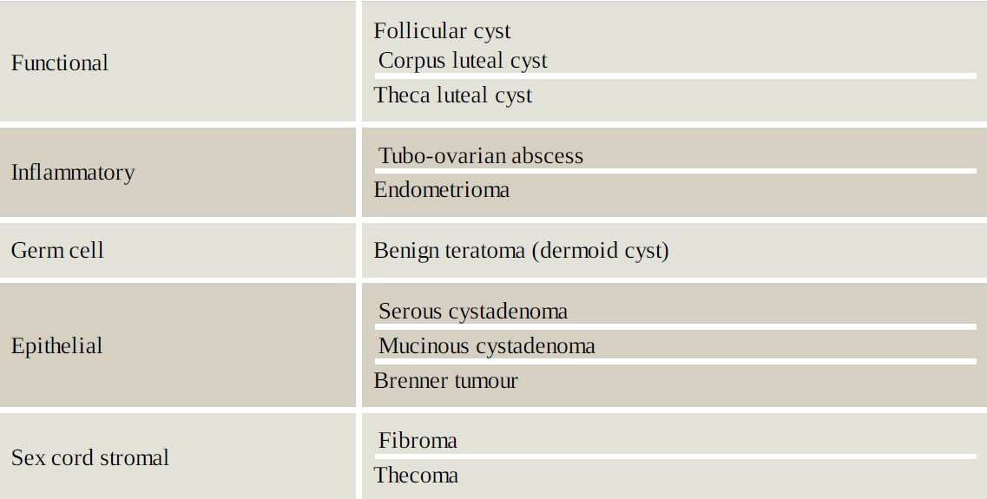
LO1 Benign and malignant diseases of the ovary Benign diseases of the ovary

Slide 4
Diagnosis
symptoms of pelvic discomfort or pressure on the bowel or bladder. Acute pain may represent torsion of a cyst, rupture or hemorrhage into it Abdominal and bimanual pelvic examination may elicit a pelvic/abdominal mass that may be tender and will be separate from the uterus
The first-line investigation for women with a suspected pelvic mass or pelvic pain is an USS. A TVUSS has better resolution for pelvic masses. A transabdominal ultrasound scan (TAUSS) is indicated in women who have never been sexually active, or in combinations with a TVUSS where large ovarian masses extending beyond the pelvis and into the abdomen are present
(CT) scanning or magnetic resonance imaging (MRI) can further characterize the nature of ovarian cysts, especially where they are thought to be potentially malignant

Slide 5
Serological tumour markers should also be taken to help determine the type of ovarian cyst and differentiate between a benign and malignant neoplasm
A pregnancy test should be performed to exclude pregnancy.
Inflammatory markers, such as C-reactive protein (CRP) and white cell count (WCC), are important if the differential diagnosis includes appendicitis or a tubo-ovarian abscess.
Tumor markers ??

Slide 6
LO 2 Ovarian torsion
Torsion of an ovary refers to a situation where there is rotation of the vascular pedicle supplying the ovary, which compresses and cuts its blood supply. Torsion is more likely with enlargement of the ovary as is seen in the presence of an ovarian cyst
Presenting symptoms are usually acute onset of lower abdominal pain associated with nausea and vomiting. Pelvic USS with Doppler measurement of blood flow may be useful in the diagnosis, to confirm the presence of a cyst and comment on blood flow to the ovary
Emergency surgical treatment to untwist the ovary and its attached pedicle is required to restore blood flow, and the ovarian cyst should then be removed. However, if this complication is not recognized within a few hours of presentation, infarction and gangrene may result, necessitating removal of the necrotic ovary

Slide 7
LO 3 Functional ovarian cysts
This group of ovarian cysts includes follicular, corpus luteal and theca luteal cysts .
Follicular cyst
diagnosis is made when the cyst measures more than 3 cm (normal ovulatory follicles measure up to 2.5 cm). They rarely grow larger than 10 cm and appear as simple unilocular cysts on ultrasound .
Management depends on symptoms: if asymptomatic, the patient can be reassured and a repeat USS performed to check resolution or non-enlargement and thereafter the patient can be discharged; if symptomatic, she can be booked for laparoscopic cystectomy if necessary.

Slide 8
Corpus luteal cysts
occur following ovulation and may present with pain due to rupture or haemorrhage, typically late in the menstrual cycle. Treatment is expectant, with analgesia.
Occasionally, surgery may be necessary if there has been significant bleeding to wash out the pelvis and perform an ovarian cystectomy.
Theca luteal cysts
are associated with pregnancy, particularly multiple pregnancy, and are often diagnosed incidentally at routine ultrasound. They are often bilateral. Most resolve spontaneously during pregnancy.

Slide 9
Inflammatory ovarian cysts
The inflammatory mass may involve the tube, ovary and bowel and can be described on imaging as a mass or an abscess. Occasionally, the tuboovarian mass can develop from other infective causes, for example appendicitis or diverticular disease.
treatment may include antibiotics, surgical drainage or excision. Definitive surgery is usually deferred until after the acute infection has resolved, due to the risks of perioperative systemic infection and bleeding from handling acutely inflamed and infected tissue.

Slide 10
LO 4 Germ cell tumours
These are the most common ovarian tumours in young women aged 20–40 years
The most common form of benign germ cell tumour is the mature dermoid cyst (cystic teratoma), which contains fully differentiated tissue types derived from all three embryonic germ cell layers (mesenchymal, epithelial and stroma). Hair, teeth, fat, skin, muscle, cartilage, bone and endocrine tissue are frequently present
Surgery is especially indicated if the dermoid cyst is symptomatic, is more than 5 cm in diameter or is enlarging. Cystectomy will prevent ovarian torsion and provide tissue for histological analysis.

Slide 11
Epithelial tumours
Benign epithelial tumours increase in frequency with age and are most common in perimenopausal women. The most common epithelial tumours are serous cystadenomas, accounting for 20–30% of benign tumours in women under 40. Serous cystadenomas are typically unilocular and unilateral, whereas mucinous cystadenomas are large multiloculated cysts that are bilateral in 10% of cases

Slide 12
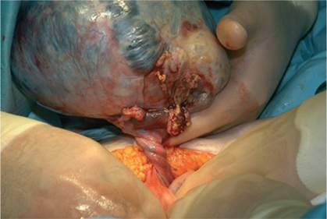
Torsion of a dermoid cyst at laparotomy

Slide 13
Ovarian fibromas are the most common sex cord stromal tumors. They are solid ovarian tumors composed of stromal cells. They present in older women, often with torsion due to the heaviness of the ovary. Occasionally, patients may present with Meig syndrome (pleural effusion, ascites and ovarian fibroma). Following removal of the ovarian fibroma, the pleural effusion will usually resolve
Thecomas are benign oestrogen-secreting tumors. They often present after the menopause with manifestations of excess estrogen production, usually postmenopausal bleeding. Although benign, they may induce an endometrial carcinoma

Slide 14
LO 5 Ovarian cancers
Incidence :
Ovarian cancer is the second most common gynaecological malignancy and the major cause of death from gynaecological cancer in the UK
The lifetime risk of developing ovarian cancer in the general population is 1.4% (1 in 70), and the mean age of presentation is 64 years, hereditary cancer present early, with a mean age at diagnosis of 54 years.
When detected in its early stages, ovarian cancer has an excellent prognosis. The dismal overall survival rates from ovarian cancer reflect the advanced stage at which most women present.

Slide 15
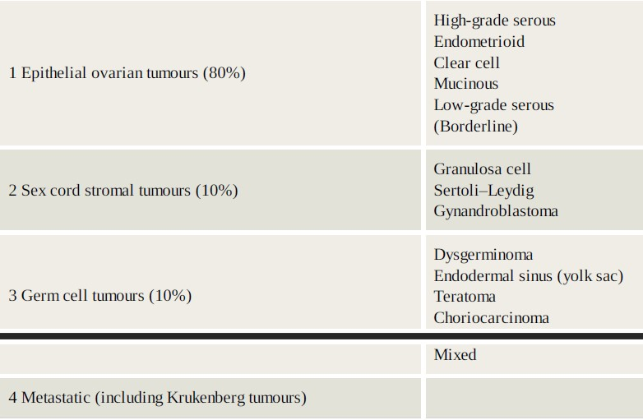
Classification of ovarian cancer

Slide 16
Epithelial tumours
Epithelial tumours of the ovary can be benign, malignant or borderline. Approximately 10% of epithelial tumours are classified as borderline ovarian tumours (BOTs). These tumours are well differentiated, with some features of malignancy (nuclear pleomorphism, cellular atypia) but do not invade the basement membrane.
The majority of BOTs are serous tumours. Mucinous BOTs may actually arise from appendiceal carcinomas of low malignant potential and can be associated with pseudomyxoma peritoneii.
High-grade serous carcinomas account for around 75% of all epithelial ovarian cancers; mucinous and endometrioid tumours are less common, accounting for 10%, followed by clear cell carcinomas
High grade serous tumours are characterized histologically by concentric rings of calcification, known as ‘psammoma bodies’.

Slide 17
Mucinous carcinomas are generally large multiloculated tumours associated with pseudomyxoma peritonei.
Endometrioid carcinomas are similar in histological appearance to endometrial cancer, are associated with endometriosis in approximately 10% of cases and also a synchronous separate endometrial cancer in 10–15%. They tend to be well differentiated and are associated with a better survival than high-grade serous carcinomas.
Clear cell carcinomas can also arise from endometriosis and are characterized histologically by clear cells, much like renal cancer.

Slide 18
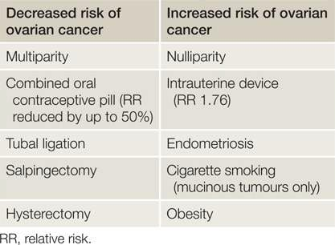
Aetiology and risk factors:

Slide 19
Genetic factors in ovarian cancer
It is estimated that at least 10–15% of women with epithelial ovarian cancer have a hereditary predisposition. Women with mutations in BRCA1, BRCA2 and Lynch syndrome have an increased lifetime risk of epithelial ovarian cancer.
The lifetime risk in the general population is one in 70 (1.4%). This rises to 1 in 20 (5%) if women have one family member affected by a defect in one of these genes and further increases to 40–50% if two first-degree relatives are affected.
The most common hereditary cancer is the breast ovarian cancer syndrome (BRCA), accounting for 90% of the hereditary cancers. This syndrome is due to a mutation of tumour suppressor genes BRCA1 (80%) and BRCA2 (15%).
Lynch syndrome is hereditary non-polyposis colorectal cancer (HNPCC) and is associated with endometrial cancer and a 10% lifetime risk of ovarian cancer.

Slide 20
Screening
Screening using transvaginal ultrasound scan (TVUSS) and CA125 measurement has not been shown to improve survival in women with a familial predisposition to ovarian cancer. This is because the high grade serous tumours that are associated with BRCA mutation carrier status develop rapidly and most are at an advanced stage before they can be picked up by screening.

Slide 21
Clinical features
Most women with ovarian cancer have symptoms; however, these symptoms are non-specific and often vague.
Increased abdominal girth/bloating.
Persistent pelvic and abdominal pain.
Difficulty eating and feeling full quickly.
Other symptoms such as change in bowel habit, urinary symptoms, back ache, irregular bleeding and fatigue occur frequently.
Pelvic and abdominal examination may reveal a fixed, hard mass arising from the pelvis.
Early-stage ovarian cancer is difficult to diagnose due to the position of the ovary, but an adenexal mass may be palpable in a slim woman.
Chest examination is important to assess for pleural fluid and the neck and groin should be examined for enlarged nodes.

Slide 22
Diagnosis and investigations
If ovarian cancer is suspected, a TVUSS is the initial imaging modality of choice to check for pelvic pathology. A pelvic mass is characterized in terms of its size, consistency, the presence of solid elements, bilaterality, the presence of ascites and extraovarian disease, including peritoneal thickening and omental deposits.
tumour markers (CA125 is a non-specific tumour marker that is elevated in over 80% of epithelial ovarian cancers. It is only raised in approximately 50% of early-stage epithelial ovarian cancers and is also commonly raised in benign conditions such as pregnancy, endometriosis and alcoholic liver disease

Slide 23
The CT scan is particularly useful for assessment of extrapelvic disease and for staging. The MRI scan helps define tissue planes and operability.
investigations required for preoperative work-up include chest X-ray, electrocardiography (ECG), full blood count, urea and electrolytes, and liver function tests.
If the patient presents with gross ascites or pleural effusion, paracentesis or pleural aspiration may be required for symptom relief and/or diagnosis. A sample of the fluid removed is sent for cytological assessment.
If the diagnosis is uncertain or if primary chemotherapy is being considered (for advanced disease, or in patients not fit to undergo surgery), a biopsy is needed before treatment can be given. This is performed laparoscopically or radiologically (ultrasound or CT-guided biopsy). Usually the omentum is a good site for biopsy.

Slide 24
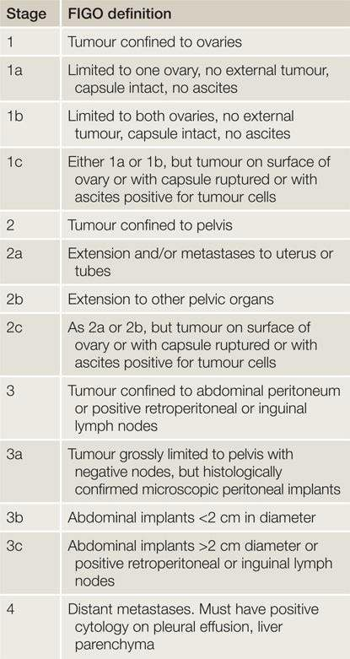
Staging:

Slide 25
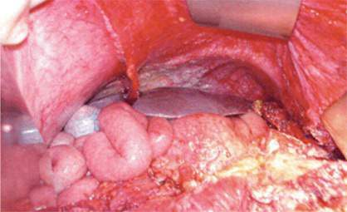
Advanced ovarian cancer illustrating diaphragmatic peritoneal disease

Slide 26
Management
Surgery
The objective of surgery is to stage accurately the disease and remove all visible tumour. This is vitallyimportant in ovarian cancer as many studies indicate that the most important prognostic factor is no residual disease following laparotomy.
A vertical incision is required to gain access to all areas of the abdomen. Ascites or peritoneal washings are sampled and a total abdominal hysterectomy and BSO performed along with an omentectomy. Further debulking may be required, possibly including resection of bowel, peritoneal stripping or splenectomy in order to remove all tumour. Lymph node resection is important, particularly in early-stage disease.
Often in advanced epithelial ovarian cancer, there is diffuse spread of disease throughout the abdominal cavity making surgical clearance of tumour very difficult.

Slide 27
‘Second-look’ surgery is a planned laparotomy at the end of chemotherapy. The main function is to assess and resect any residual disease. Data on second-look surgery indicate no survival benefit

Slide 28
Chemotherapy
Chemotherapy can be given as primary treatment, as an adjunct following surgery or for relapse of disease.First-line treatment is usually a combination of a platinum compound with paclitaxel. Most regimes are given on an outpatient basis, 3 weeks apart for six cycles.
Platinum compounds are the most effective chemotherapeutic agents in ovarian cancer. They are heavy metal agents that cause cross linkage of deoxyribonucleic acid (DNA) strands, thus arresting cell replication.
Carboplatin is now the main platinum compound used as it is less renal toxic and causes less nausea than cisplatin, but is equally as effective. The dose of carboplatin is calculated according to the glomerular filtration rate
Following completion of chemotherapy, patients have a further CT scan to assess response to treatment. This scan can be used for comparison in the future if there is clinical or biochemical evidence of recurrence.

Slide 29
Follow-up of patients includes clinical examination and CA125 measurement. Studies have shown that levels of CA125 start to rise prior to onset of clinical evidence of disease recurrence; however, treating isolated rising CA125 levels does not improve survival.

Slide 30
Prognosis
Stage of disease
Volume of residual disease post surgery
Histological type and grade of tumour
Age at presentation
overall 5-year survival for stage 1 disease is over 90% compared to 30% for stage 3 disease.

Slide 31
LO 6 Sex cord stromal tumours
These tumours account for approximately 10% per cent of ovarian tumours, but almost 90% cent of all functional (i.e. hormone-producing) tumours.
granulosa cell tumours are the most common subtype, accounting for over 70% of sex cord stromal tumours.

Slide 32
Clinical features
A significant percentage of these tumours present with manifestations of their hormone production, typically irregular menstrual bleeding, postmenopausal bleeding or precocious puberty in young girls.
Granulosa cell tumours may present as a large pelvic mass or with pain due to torsion/haemorrhage
Sertoli–Leydig cell tumours produce androgens in over 50% of cases. Patients present with a pelvic mass and signs of virilization. Common symptoms are amenorrhea , deep voice and hirsutism.
Occasionally, this group of tumours produce oestrogen and rarely renin, causing hypertension

Slide 33
Treatment
Treatment is based on the patient’s age and wish to preserve fertility. If the patient is young, unilateral salpingo-oophorectomy, endometrial sampling and staging is sufficient. In the older group, full surgical staging is recommended.

Slide 34
Germ cell tumours
Malignant germ cell tumours occur mainly in young women and account for approximately 10% of ovarian tumours.
Dysgerminomas account for 50% of all germ cell tumours. They are bilateral in 20% of cases and occasionally secrete human chorionic gonadotrophin (hCG).
Endodermal sinus yolk sac tumours are the second most common germ cell tumours, accounting for 15% of the total. They are rarely bilateral and secrete α-fetoprotein (AFP). They present with a large solid mass that often causes acute symptoms with torsion or rupture .
Immature teratomas account for 15–20% of malignant germ cell tumours and about 1% of all teratomas. They are classified as mature or immature depending on the grading of neural tissue present.
Non-gestational choriocarcinomas are very rare, usually presenting in young girls with irregular bleeding and very high levels of hCG.

Slide 35
Treatment
Surgery is tailored to suit the patient. As most women presenting with malignant germ cell tumours are of reproductive age, fertility-sparing treatment may be preferred. An exploratory laparotomy is performed to remove the tumour and assess contralateral spread to the other ovary (20% in dysgerminoma). If there is a cyst present on the other ovary, this should be removed. Careful inspection of the abdominal cavity is required with peritoneal biopsies and sampling of any enlarged pelvic or para-aortic nodes performed
Postoperative chemotherapy depends on stage of disease. The most common regime used is a combination of bleomycin, etoposide and cisplatin (BEP), given as a course of three to four treatments, 3 weeks apart .

Slide 36
THANK YOU

